Slide 1
Chapter 9: Virtual Memory

Slide 2
Chapter 9: Virtual Memory
Page Replacement
Allocation of Frames
Thrashing
Memory-Mapped Files
Allocating Kernel Memory
Other Considerations
Operating-System Examples

Slide 3
Objectives
To explain the concepts of page-replacement algorithms, and allocation of page frames
To discuss the principle of the working-set model
To examine the relationship between shared memory and memory-mapped files
To explore how kernel memory is managed

Slide 4
Page and Frame Replacement Algorithms
Page replacement completes separation between logical memory and physical memory – large virtual memory can be provided on a smaller physical memory
Frame-allocation algorithm determines
  How many frames to give each process
  Which frames to replace

Slide 5
Page and Frame Replacement Algorithms
Page-replacement algorithm
  Which frames to replace
  Want lowest page-fault rate on both first access and re-access
Evaluate algorithm by running it on a particular string of memory references (reference string) and computing the number of page faults on that string
  String is just page numbers, not full addresses
  Repeated access to the same page does not cause a page fault
  Results depend on number of frames available
In all our examples, the reference string of referenced page numbers is
7,0,1,2,0,3,0,4,2,3,0,3,0,3,2,1,2,0,1,7,0,1

Slide 6

Graph of Page Faults Versus The Number of Frames

Slide 7
Page replacement strategies
If all pages in physical memory are occupied, and a page fault occurs which page should be displaced from physical memory to make room for the new page?
The following strategies all have advantages and disadvantages
  Random Replacement
  FIFO
  Least Recently Used
  Optimal
  Least Frequently Used
  Most Frequently Used

Slide 8
Random Replacement
Chose the page to be replaced in physical memory at random
The advantage here is low overhead in the selection process
The disadvantage is unpredictability –you may select the page that will be referenced in the next instruction

Slide 9
First-In-First-Out (FIFO) Algorithm
Chose the page that has been in physical memory the longest period of time
The advantage is ease of implement through a FIFO queue
The disadvantage is that you may replace a heavily used page

Slide 10
First-In-First-Out (FIFO) Algorithm
Assume that we have a system with only three frames in main memory and that we have only one process running
The following string of page references is made by the process as it executes:
7,0,1,2,0,3,0,4,2,3,0,3,0,3,2,1,2,0,1,7,0,1
3 frames (3 pages can be in memory at a time per process)
1
7
2
4 0 7
2
0
3
15 page faults
2 1 0
3
1
0
3 2 1

Slide 11
First-In-First-Out (FIFO) Algorithm
Can vary by reference string: consider 1,2,3,4,1,2,5,1,2,3,4,5
  Adding more frames can cause more page faults!
    Belady’s Anomaly
How to track ages of pages?
  Just use a FIFO queue

Slide 12
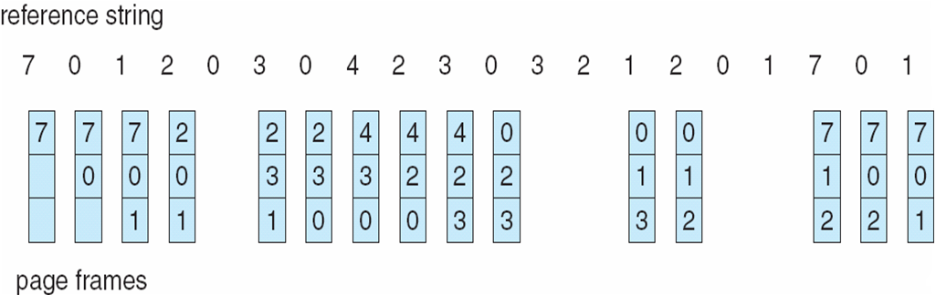
First-In-First-Out (FIFO) Algorithm

Slide 13

FIFO Illustrating Belady’s Anomaly

Slide 14
Optimal Algorithm
Replace page that will not be used for longest period of time
  9 is optimal for the example
How do you know this?
  Can’t read the future
Used for measuring how well your algorithm performs

Slide 15

Optimal Algorithm

Slide 16

Least Recently Used (LRU) Algorithm
Use past knowledge rather than future
Replace page that has not been used in the most amount of time
Associate time of last use with each page
12 faults – better than FIFO but worse than OPT
Generally good algorithm and frequently used
But how to implement?

Slide 17
LRU Algorithm (Cont.)
Counter implementation
  Every page entry has a counter; every time page is referenced through this entry, copy the clock into the counter
  When a page needs to be changed, look at the counters to find smallest value
    Search through table needed
Stack implementation
  Keep a stack of page numbers in a double link form:
  Page referenced:
    move it to the top
    requires 6 pointers to be changed
  No search for replacement
  But each update more expensive
LRU and OPT are cases of stack algorithms that don’t have Belady’s Anomaly

Slide 18

Use Of A Stack to Record Most Recent Page References

Slide 19
LRU Approximation Algorithms
LRU needs special hardware and still slow
Reference bit
  With each page associate a bit, initially = 0
  When page is referenced bit set to 1
  Replace any with reference bit = 0 (if one exists)
    We do not know the order, however
Second-chance algorithm
  Generally FIFO, plus hardware-provided reference bit
  Clock replacement
  If page to be replaced has
    Reference bit = 0 -> replace it
    reference bit = 1 then:
      set reference bit 0, leave page in memory
      replace next page, subject to same rules

Slide 20

Second-Chance (clock) Page-Replacement Algorithm

Slide 21
Enhanced Second-Chance Algorithm
Improve algorithm by using reference bit and modify bit (if available) in concert
Take ordered pair (reference, modify)
  (0, 0) neither recently used not modified – best page to replace
  (0, 1) not recently used but modified – not quite as good, must write out before replacement
  (1, 0) recently used but clean – probably will be used again soon
  (1, 1) recently used and modified – probably will be used again soon and need to write out before replacement
When page replacement called for, use the clock scheme but use the four classes replace page in lowest non-empty class
  Might need to search circular queue several times

Slide 22
Counting Algorithms
Keep a counter of the number of references that have been made to each page
  Not common
Lease Frequently Used (LFU) Algorithm: replaces page with smallest count
Most Frequently Used (MFU) Algorithm: based on the argument that the page with the smallest count was probably just brought in and has yet to be used

Slide 23
Page-Buffering Algorithms
Keep a pool of free frames, always
  Then frame available when needed, not found at fault time
  Read page into free frame and select victim to evict and add to free pool
  When convenient, evict victim
Frame buffer
Disk
Process 1
frames
Free frames

Slide 24
Page-Buffering Algorithms
Possibly, keep list of modified pages
  When backing store otherwise idle, write pages there and set to non-dirty
Possibly, keep free frame contents intact and note what is in them
  If referenced again before reused, no need to load contents again from disk
  Generally useful to reduce penalty if wrong victim frame selected
Frame buffer
Process 1
frames
Disk
Free frames

Slide 25
Allocation of Frames
Each process needs minimum number of frames
Example: IBM 370 – 6 pages to handle SS MOVE instruction:
  instruction is 6 bytes, might span 2 pages
  2 pages to handle from
  2 pages to handle to
Maximum of course is total frames in the system
Two major allocation schemes
  fixed allocation
  priority allocation
Many variations

Slide 26


Fixed Allocation
Equal allocation – For example, if there are 100 frames (after allocating frames for the OS) and 5 processes, give each process 20 frames
  Keep some as free frame buffer pool
Proportional allocation – Allocate according to the size of process
  Dynamic as degree of multiprogramming, process sizes change

Slide 27
Priority Allocation
Use a proportional allocation scheme using priorities rather than size
If process P_{i} generates a page fault,
  select for replacement one of its frames
  select for replacement a frame from a process with lower priority number

Slide 28
Global vs. Local Allocation
Global replacement – process selects a replacement frame from the set of all frames; one process can take a frame from another
  But then process execution time can vary greatly
  But greater throughput so more common
Local replacement – each process selects from only its own set of allocated frames
  More consistent per-process performance
  But possibly underutilized memory

Slide 29
Non-Uniform Memory Access
So far all memory accessed equally
Many systems are NUMA – speed of access to memory varies
  Consider system boards containing CPUs and memory, interconnected over a system bus
Optimal performance comes from allocating memory “close to” the CPU on which the thread is scheduled
  And modifying the scheduler to schedule the thread on the same system board when possible
  Solved by Solaris by creating lgroups
    Structure to track CPU / Memory low latency groups

Slide 30
End

